Slide 1

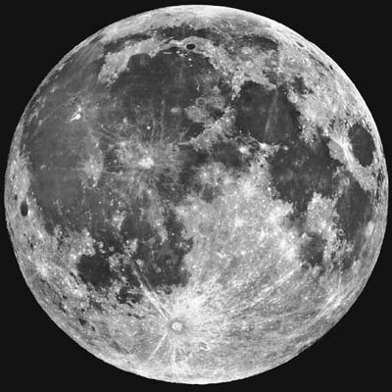
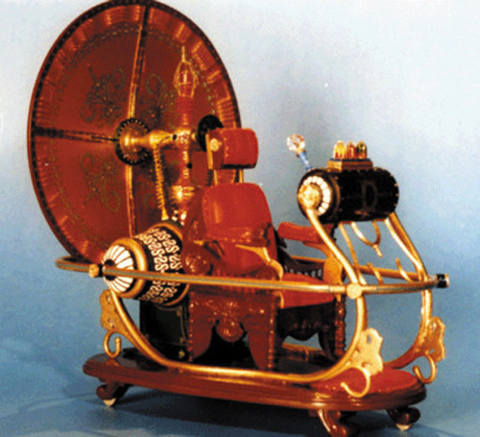



Worlds of Science and Imagination

Slide 2

Zeta Ursae Majoris Through the Telescope
Zeta Ursae Majoris is more commonly known as Mizar.
When seen through the telescope, Mizar turns out to be not one, but two stars. They are called A and B

Slide 3

Multiple Stars in Sci Fi
In both science fiction literature and film, authors have created worlds orbiting multiple suns.

Slide 4

Multiple Stars in Sci Fi
Star Wars (1977) featured Tatooine, Luke Skywalker’s and Anakin’s home planet, which had twin suns.

Slide 5

Multiple Stars in Sci Fi
In Isaac Asimov’s story Nightfall (1941), the planet Legash has 6 suns so there is eternal sunlight except once every 2049 years …

Slide 6

Multiple Stars in Sci Fi
The Hitchhiker’s Guide to the Galaxy (1979) features the planet Magrathea with twin suns where they manufactured bespoke planets for the very wealthy.

Slide 7

Multiple Stars in Sci Fi
In the Jim Henson movie, Dark Crystal (1982), the world, Thra has three suns.

Slide 8

Mizar in the Night Sky
Mizar is the middle star of the handle of the Big Dipper, which is actually part of the constellation Ursa Major, the Great Bear.
Big Dipper
Ursa Major
Mizar

Slide 9

Mizar in the Night Sky
If you look closely at the Big Dipper you can see that Mizar has a companion star called Alcor.
Alcor
Mizar
The ability to spot Alcor was traditionally used as an eye test!

Slide 10

Mizar in the Night Sky
Mizar and Alcor form a wide trio of stars.
Alcor
Mizar A & B

Slide 11
Binary or Multiple Stars
The distance from Earth to Mizar A & B is about 78 light years.
Mizar A & B are 47 billion miles (345 AU) apart.
Mizar A & B orbit each other every 5,000 years. This makes Mizar a binary star system.

Slide 12


Mizar - Multiple Stars
Mizar A & B are actually each binary stars themselves!
Mizar Aa Ab
Mizar Ba Bb
Thus Mizar is a 4 star system

Slide 13
Mizar - Multiple Stars
Mizar Aa and Ab are 0.3 AU apart and orbit each other every 20 days.
Mizar Ba and Bb are 3 AU apart and orbit each other every 57 years.

Slide 14

Multiple-Double
The Mizar system and Alcor are about 3 light years apart - close neighbors but not orbiting each other.
Thus, Mizar-Alcor is an optical double.

Slide 15
Star Pairs
Alcor and the stars of Mizar are blue to white stars - somewhat hotter than our Sun.
They are similar to our Sun, but a bit hotter. They will also have shorter lives.

Slide 16
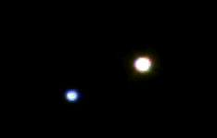

Star Pairs
Pairs of stars come in two varieties:
Optical Double Stars
Binary Stars

Slide 17

Optical Double Stars
Optical Double stars are just two stars that happen to lie in the same direction in the sky.
(A side view)
If you could see these stars from somewhere in space other than Earth, you would see that they have nothing to do with each other.

Slide 18


Binary or Multiple Stars
In a Binary (or Multiple) star system the stars are relatively close and orbit each other.

Slide 19

Multiple or Optical Double?
It's all in the distance.
Optical double stars are very large distances apart but appear to be close together because they are in the same line-of-sight.
Multiple stars lie close to each other in space and at about the same distance from Earth.

Slide 20
How Can You Find the Distance to a Star?
Earth
Nearby star
ρ
Background stars
Sun
d
ρ
Apparent positions of the nearby star for observations taken 6 months apart.
The position of a nearby star from different sides of our orbit around the Sun make it seem to shift in the sky. This shift, called parallax, can be used to find the distance to nearby stars.

Slide 21
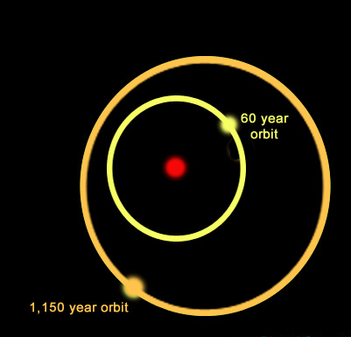
Multiple Star Systems
Star systems come in many varieties. For example, the system shown here is a triple star system:
A yellow star orbits a primary star with a period of nearly 60 years while a more distant companion orbits the inner pair with a period of 1,150 years.
One multiple star system we know of has 9 stars!

